Slide 1
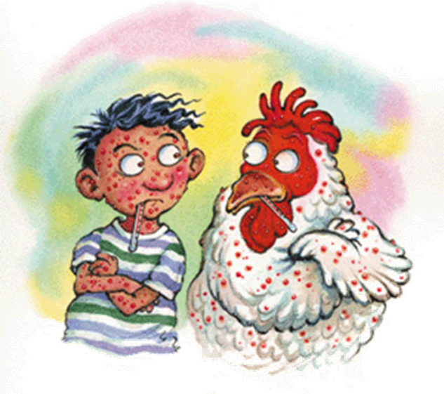
CHICKEN POX
DR.ARUN R.NAIR
Dept Of pm

Slide 2
INTRODUCTION
Varicella-zoster virus (VZV) causes two distinct clinical entities: varicella (chickenpox) and herpes zoster (shingles). Chickenpox, a ubiquitous and extremely contagious infection, is usually a benign illness of childhood characterized by an exanthematous vesicular rash.

Slide 3
ETIOLOGY
The etiological agents of varicella and herpes zoster are identical in all respects. The varicella zoster (V-Z) virus is a DNA virus measuring 100-150 nm in diameter.
It is an exclusively human herpes virus that causes chickenpox (varicella), become latent in cranial nerves and dorsal root ganglia, to be reactivated later to produce shingles (zoster) and post-herpetic neuralgia.
VARICELLA ZOSTER VIRUS CAN CAUSE TWO DISTINCT LESIONS
CHICKENPOX – PRIMARY LESION
HERPES ZOSTER – REACTIVATED LESION

Slide 4
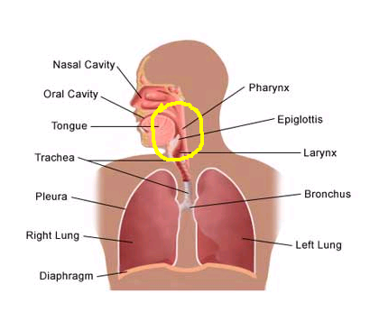
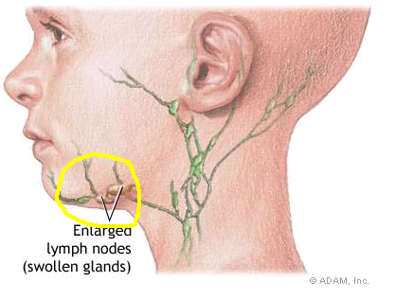
PATHOGENESIS & PATHOLOGY
DAY 0-3 - INFECTION OF CONJUCTIVAE AND MUCOSA OF THE UPPER RESPIRATORY TRACT.
VIRAL REPLICATION IN REGIONAL LYMPH NODES.
DAY 4-6 - PRIMARY VIREMIA,VIRAL INFECTION IN LIVER, SPLEEN AND OTHER ORGANS .
(RETICULOENDOTHELIAL
CELLS)

Slide 5
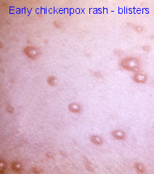
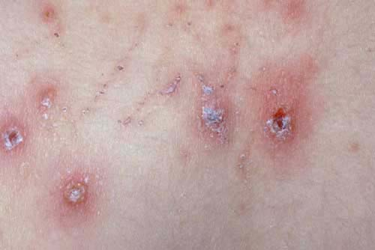
DAY 10-12 - SECONDARY VIREMIA
DAY 14 - INFECTIN OF SKIN AND APPERANCE OF VESICULAR RASH
EXCORIATION

Slide 6
1ST EXPOSURE
BODY FIRST EXPOSED CREATES ANTIBODIES
IgM
IgG
IgA
B & T MEMORY CELLS ARE ALSO CREATED
IF THE VIRUS IS IN THE BODY AGAIN THE MEMORY CELLS WILL DETECT IT.
THIS WILL HELP A FASTER RESPONSE.
IF THERE IS A 2ND EXPOSURE,MEMORY CELLS WILL STIMULATE TO CREATE ANTIBODIES.

Slide 7
TRANSMISSION
Incubation period usually(14-17 days)
Prodome(1-3 days)
Vesicles
Pustules
Scabs
Recovery typically 7 days after rash appears
ACQUIRED BY INHALING VIRUS CONTANING PARTICLES,TRAPPED IN TINY DROPLETS RELEASED INTO THE AIR FROM THE NOSE OR THROAT OF AN INFECTED PERSON .
THE VIRUS ENTERS THE BODY BY INFECTING CELLS IN THE RESPIRATORY TRACT.
IT SPREADS TO MANY OTHER PARTS OF THE BODY,INCLUDING THE SKIN,WHERE IT CAUSES THE CHARACTERISTIC RASH.

Slide 8
EPIDEMIOLOGY AND CLINICAL MANIFESTATIONS
Humans are the only known reservoir for VZV.
Chickenpox is highly contagious,with an attack rate of at least 90% among susceptible (seronegative)individuals.
Persons of both sexes and all races are infected equally often.
Seasonal peaks—namely, late winter and early spring in the temperate zone.
The incubation period of chickenpox ranges from 10 to 21 days but is usually between 14 and 17 days.

Slide 9
Clinically
Clinically, chickenpox presents as a rash, low-grade fever, and malaise, although a few patients develop a prodrome 1 to 2 days before onset of the exanthem.
A benign illness that is associated with lassitude and with body temperatures of 37.8 to 39.4 C (100 to 103 F) of 3 to 5 days’ duration.
The skin lesions—the hallmark of the infection—include maculopapules, vesicles, and scabs in various stages of evolution. These lesions, which evolve from maculopapules to vesicles over hours to days, appear on the trunk and face and rapidly spread to involve other areas of the body. Most are small and have an erythematous base with a diameter of 5 to 10 mm.

Slide 10
The vesicles are unilocular, superficial, elliptical in shape and contain clear fluid in the beginning (tear drop vesicles). These become pustular in 24 hours.
The pustules dry up to form scabs in a few days. When the scabs fall off, superficial scars are left behind which clear up in due course. Recovery is the rule in the vast majority of healthy subjects.
The most common infectious complication of varicella is secondary bacterial superinfection of the skin, which is usually caused by Streptococcus pyogenes or Staphylococcus aureus.

Slide 11
SYMPTOMS
LOSS OF APETITE
COLD
FEVER
ABDOMINAL PAIN
HEADACHE
GENERAL FEELING OF lLLNESS
RASH
FATIGUE
SORE THROAT
FEVER MAY BE HIGH FOR FIRST FEW DAYS

Slide 12
COMPLICATION
CNS. The syndrome of acute cerebellar ataxia and meningeal irritation generally appears 21 days after the onset of the rash and rarely develops in the preeruptive phase. The cerebrospinal fluid (CSF) contains lymphocytes and elevated levels of protein.
CNS involvement -Aseptic meningitis, encephalitis, transverse myelitis, Guillain-Barre´ syndrome, and Reye’s syndrome can also occur.
complications of chickenpox include myocarditis, corneal lesions, nephritis, arthritis, bleeding diatheses, acute glomerulonephritis, and hepatitis.
Hepatic involvement, distinct from Reye’s syndrome and usually asymptomatic, is common in chickenpox and is generally characterized by elevated levels of liver enzymes, particularly aspartate and alanine aminotransferases.

Slide 13
COMPLICATION
Other systemic complications that may develop rarely are myocarditis, keratitis, iritis, nephritis, arthritis, purpura, orchitis and appendicitis.

Slide 14
INCREASED RISK OF COMPLICATION
Varicella pneumonia - is the most serious complication following chickenpox, developing more commonly in adults than in children. It usually has its onset 3 to 5 days into the illness and is associated with tachypnea, cough, dyspnea, and fever. Cyanosis, pleuritic chest pain, and hemoptysis are frequent. Roentgenographic evidence of disease consists of nodular infiltrates and interstitial pneumonitis.
Perinatal varicella - is associated with a high mortality rate when maternal disease develops within 5 days before delivery or within 48h thereafter. Because the newborn does not receive protective transplacental antibodies and has an immature immune system, the illness may be unusually severe.
Congenital varicella - with clinical manifestations of limb hypoplasia, cicatricial skin lesions, and microcephaly at birth, is extremely uncommon.

Slide 15
DIAGNOSIS
BY SIGNS & SYMPTOMS
LAB DIAGNOSIS

Slide 16
DIAGNOSIS of Chicken pox
Leukopenia is typical during the 1st 72 hr; it is followed by
lymphocytosis.
Liver function tests usually (75%) mildly elevated.
CSF:
In CNS complications:
- lymphocytic pleocytosis (more than normal).
- increase in protein
- glucose concentration is usually normal.

Slide 17
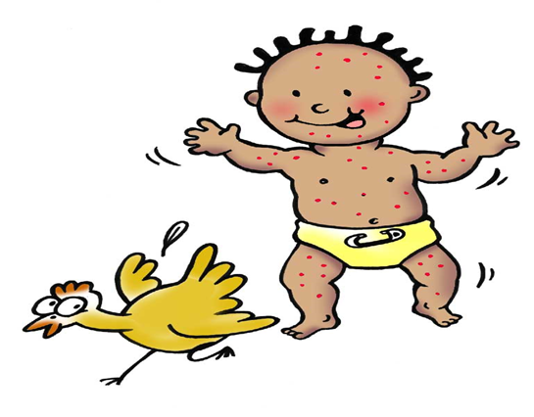
Quick direct fluorescence assay of cells from cutaneous lesions,
PCR.(polymerase chain reaction)
tissue culture.
VZV IgG antibodies: 4-fold rise
VZV-specific IgM assays

Slide 18
Good bye till we meet again with good news.... take care…

